Slide 1
Bite Sized Development
Increase Participation, Creativity & Knowledge Exchange
Colin Gray | @elearningcolin |
University of Abertay Wild Trails Media

Slide 2
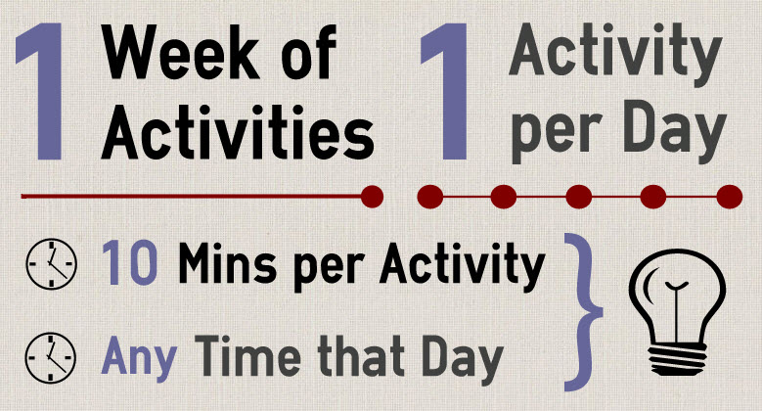
How Does it Work?
Notes:
This is an example, although I’ve used variations

Slide 3
Why Should it Work?
Flexible, short, just-in-time learning
(Simkins & Maier, 2010)
Community of Practice
(Lave & Wenger, 1991)
Attention spans - 90/20/8 rule
(Pike, 1994)
Notes:
Robert Pike – 90/20/8 rule
an audience can listen with understanding for 90 minutes, but they only retain 20 minutes of the information presented. They need to discuss and apply what they're learning every 8 minutes.

Slide 4
Where Has it Worked?
Edinburgh Napier
In the Cloud
Podwhating?!
Web2 and You
Open Education
How to Podcast
Business Education
Chiasma
Helen Webster
10 Days of Twitter & LD5D
23 Things
PLCMC & Cambridge
Notes:
Digital things for learning developers (LD5D) & 10 days of twitter
Public Library of Charlotte & Mecklenburg County – 2006 originally – Learning 2.0 programme to get staff into New techs.
CPD23 – Niamh Page – Cambridge Librarians and info services – 1000 participants in 2011 and 360 in 2012.

Slide 5
What’s Your Experience?
?
Have you participated in
an online course?
ODD
What did
you like?
EVEN
What didn’t
you like?
Notes:
Take some cards – numbers only
Deal the cards out to the tables
Odd numbers do one, even numbers do the other.

Slide 6
Putting it in Context
1
Briefly introduce your own area
Pick one topic to teach using Bite-Sized
Devise 2 or 3 tasks for that topic
2
3
Notes:
Split into 4 groups, by suit.

Slide 7
Research on Engagement
The Course Drain
Notes:
The Big Issue is Retention
I’m looking at Engagement

Slide 8
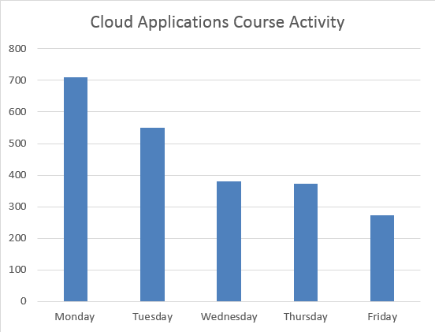
“In the Cloud” | 18 x
Final Day
Any Action:
39%
Average:
62%
“In the Cloud” Course – Edinburgh Napier, 2012

Slide 9
“Web2 and You” | 12 x
Average actions:
42%
Weekly Actions:
90%
Final Day

Slide 10
Research on Engagement
Similar measurements across the board
My Courses
Colleagues
MOOCs
39%
29%
12%
Notes:
Retention problems are huge
MOOCs too: Edinburgh Uni, 29% engagement with week 5
Niamh tumelty from cambridge
2011 – 959 participants and 112 completed – 12%
2012 – 361 participants and 44 completed – 12%

Slide 11
Increasing Engagement
(My thoughts and experience, at least….)
1
Prime Your Participants
2
Lay Down the Law
3
Be the Snowball
4
Jump the Rails

Slide 12
Increasing Engagement
(My thoughts and experience, at least….)
1
Prime Your Participants
T-5 days
-5 to 0 days
Day 1
Notes:
1 Email – Intro & Pre-Activity
Icebreaker pre-activity (preempts tech probs too)
Monday Morning

Slide 13
Lay Down the Law
2
Lay Down the Law
Prod Them!
Guilt Them!
Guilt Them, again!
Notes:
Heavy prods!
Guilt, guilt, guilt
Your time
Responsibility to others

Slide 14
Be the Snowball
3
Be the Snowball
Plant the
Seeds
Heavy
Lifting
Watch it
Grow
Notes:
Mixing all sorts of metaphors here
Plant the seeds with the pre-course activity – gives them nourishment to base course relationships on
You’re then doing the heavy lifting

Slide 15
Jump the Rails
4
Jump the Rails
Get Creative
& Responsive
Participant
Content
Prompt Creative
Outputs
Notes:
This isn’t just an on-rails co
The benefits of flexibility and short tasks are that you can change them easily!
And student generated content takes a lot of the burden off you.
Be creative, be responsive
- Take votes, take suggestions, and act on them
Post Participant content – encourage this
Create tasks that will produce creative outputs

Slide 16
Putting it in Context
1
What would work with your learners?
Your experience with this, or others?
Ideas for new engagement tactics?
2
3
Notes:
Discussion around these results - Pose the following questions.
Whole group participation. (If slow going then split into small groups again to try to stimulate some creative thinking around the topic.)
Which engagement tactics do you think would work in your context?
Have you experience with any of these approaches? If so, what happened?
Can you think of any other methods of engagement that might work in this context?

Slide 17
Bite Sized Development
Increase Participation, Creativity & Knowledge Exchange
Colin Gray
T: @elearningcolin
E: colin@wildtrails.co.uk
University of Abertay Dundee & Wild Trails Media

